Slide 1



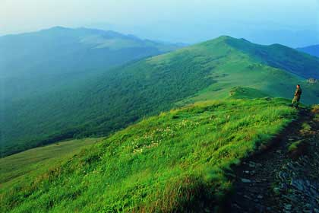
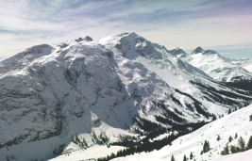
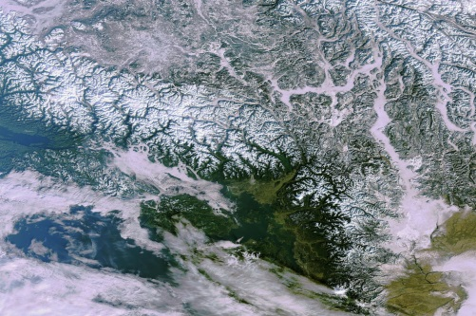
UNEP’s work on mountain ecosystems in
Central Asia – An update
Meeting of the ICSD,
Aşgabat, 16 June 2015
Ms. Natalia Alexeeva
Head of Sub-Regional Office for Central Asia
UNEP Regional Office for Europe
.
Notes:
1
1

Slide 2
OUTLINE
Update on UNEP’s activities on mountain ecosystems in Central Asia
  Regional assessment on mountains and climate change adaptation
  Cooperation with IAEA Assessing the Impact of Climate Change on Land-Water- Ecosystem Quality in Polar and Mountainous Regions
  Global Mountain Waste Outlook
.
Notes:
2
2

Slide 3
UNEP in Central Asia
Active in the region since the early 2000s
Focal areas
Continuous work with IFAS/ICSD and Central Asian countries
Resource efficiency: Green Economy & Sustainable Consumption and Production
Environmental Governance
Chemicals and Waste
Ecosystems & climate change adaptation
Poverty and environment
Notes:
3
3
Facing all these major environmental challenges UNEP has been an active and trusted actor in Central Asia for a long time. It started its involvement in the early 2000s and has been engaged ever since. It has always been of great importance to UNEP to work together with local partners. Hence close relationships have been formed with relevant environmental actors from the region for example with the Interstate Commission for Sustainable Development. Together with these partners UNEP mainly engages in the areas Green Economy, Environmental Governance, Chemicals and Waste and Ecosystems
Examples of regional initiatives:
Central Asian Leadership Programme on Education for Sustainable Development
Policy Framework for Promotion of Low Carbon Emission Societies - Within the project “Capacity Building in Development of Policy Framework for Promotion of Low Carbon Emission Societies in Central Asia”, a network of climate change focal points and experts as well as mechanisms for the exchange of information and experiences were established to enhance institutional capacity and awareness. Furthermore plans for cleaner technologies were accepted for national implementation and increased application of improved energy performance standards was achieved.
Assessment of Environment and Security Linkages in the Amu Darya River Basin
Examples of country initiatives:
Poverty & Environment (Kyrgyzstan and Tajikistan)
National Sustainable Development Strategies
Environmental Impact Assessments
Kyrgyz Republic Mercury Mince Closure Project
3

Slide 4
UNEP Activities in Mountain Regions
Key priority: Ecosystem Management and Climate Change
Project: “Climate change action in developing countries with fragile mountainous ecosystems from a sub-regional perspective”*
Duration: 2014-2017
Targeted (sub)-regions: East Africa, Balkans, (South)Caucasus, Central Asia, (Tropical) Andes
Background:
Mountains as an early indicator of climate and developing countries with fragile mountainous ecosystems as particularly vulnerable to the adverse effects of climate change
Need for sub-regional and holistic approaches in the field of climate change adaptation in mountain areas
* The UNEP led project “Climate change action in developing countries with fragile mountainous ecosystems from a (sub)regional perspective” is financially co-supported by Austria through its contribution to UNEP in the context of the Fast-Start Finance (FSF) Mechanism of the UNFCCC.

Slide 5
UNEP Activities in Mountain Regions
Objective: Support to mountainous developing countries to integrated mountain specific climate change adaptation into relevant development policies/plans/strategies from a sub-regional perspective
Understand climate change vulnerabilities and impacts (synthesize information)
Analysis of relevant policies and frameworks and bottlenecks
Support policy action from a sub-regional perspective
Inter-regional exchange of experiences with other mountain regions (in particular regional mechanisms such as Alpine and Carpathian Convention)
Main Outputs:
Participatory assessments related to climate change and adaptation to be published at COP21 UNFCCC, Paris
(Inter)-regional platforms and support development/review of sub-regional climate change action plans/strategic agendas etc. in context of relevant institutional mechanisms/frameworks (e.g. East African Community for East Africa, ICSD for CA)

Slide 6


UNEP Activities in Mountain Regions
Forthcoming steps:
(Sub)-Regional stakeholder consultations (review of background document) to be held 13-14 July 2015 in Almaty (final dates and venue tbc!)
Finalization of Assessment on climate change and adaptation to be published at UNFCCC COP21, Paris, December 2015
Seeking the development of concrete follow-up action towards technical assistance provided by Climate Technology Centre & Network (CTCN, Copenhagen) provided by UNEP and UNIDO
Planned joint side event with other international partners at UNFCCC COP21, Paris (on the occasion of International Mountain Day, 11 December):Presentation of five regional assessments incl.CA
Joint UNESCO – UNEP – GRID-Arendal public exhibition on mountains and climate change at UNFCCC/COP 21 in Paris using Earth Observation/satellite images
Notes:
Interaction with CTCN: what kind of interaction?

Slide 7

UNEP Activities in Mountain Regions - Cooperation with other UN agencies: IAEA
Project: Assessing the Impact of Climate Change on Land-Water- Ecosystem Quality in Polar and Mountainous Regions*
Duration: 2014-2017
Research sites: Africa, North and South America, Asia and Europe
Background: Climate change is ‘the defining human development challenge of the 21st century’. Nowhere are its effects more visible than in the polar and mountainous regions. Examining the impacts of climate change in Antarctic and Arctic landscapes using Isotope and nuclear techniques can be particularly useful for a better understanding of the future impacts of climate change on landscape dynamics in mountainous regions across the world.
Notes:
Project info: http://www.iaea.org/inis/collection/NCLCollectionStore/_Public/45/086/45086151.pdf

Slide 8
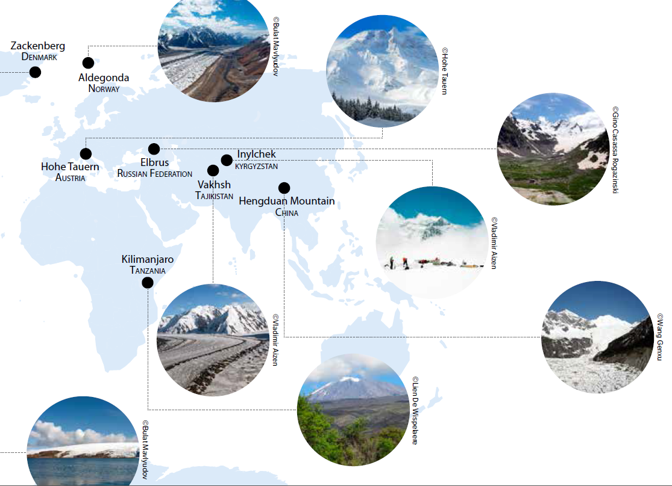
Notes:
Benchmark sites (geographic point of reference reflecting the major issues and trends of climate change impact) in Tajikistan and Kyrgyzstan

Slide 9
Objective:
Improved understanding of the impact of climate change on fragile polar and mountainous ecosystems on both a local and global scale for their better management and conservation;
Recommendations for improvement of regional policies for soil and agricultural water management, conservation, and environmental protection in polar and mountainous regions.
Main Outputs:
Methodologies
Networks
Capacity building
Awareness raising
Adaptation Strategies
Notes:
Methodologies: Methodologies and protocols for assessing climate change impact on cryosphere and land-water-ecosystem quality in specific polar and mountain ecosystems and proposing conservation or adaptation measures for agriculture areas.
Networks: Methodologies and protocols for assessing climate change impact on cryosphere and land-water-ecosystem quality in specific polar and mountain ecosystems and proposing conservation or adaptation measures for agriculture areas
Capacity building: Trained young scientists in the use of isotope and nuclear techniques to assess the impact of climate change
Awareness raising: Improved understanding of the effects of climate change disseminated through appropriate publications, policy briefs, and through a dedicated internet platform
Adaptation Strategies: Specific strategies to minimize the adverse effects of, and adapt to, reduced seasonal snow and glacier covered areas on land-waterecosystem quality in polar and mountain regions across the world

Slide 10
UNEP Activities in Mountain Regions
Key priority: Waste management
Project: Global Waste Management Outlook – Mountain Countries
Duration: 2015-2016
Targeted regions: Global – Africa, Andes, HKH, Central Asia, etc.
Background:
Rapidly increase per capita waste generation rates in the Mountain Countries due to increasing tourism, urbanisation, extractive industries, energy production, consumption and changes in lifestyles
Additional pressure on the sensitive mountain ecosystems and their people in addition to the already existing challenges (e.g.climate change, melting of glaciers)
Implications of unsustainable management of waste on the upstream and downstream communities (e.g. through polluted water-run-off)

Slide 11
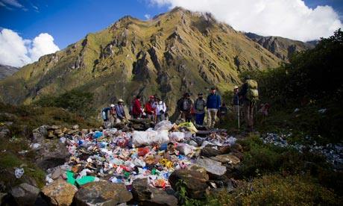

UNEP Activities in Mountain Regions
Objective: In close cooperation with UNEP’s International Environmental Technology Centre (IETC) develop a highly visual Waste Management Outlook in Mountain Countries including trends, challenges, policies in waste prevention, minimization and managements
Raise awareness on holistic approach for integrated waste management;
Converting waste into a resource for growth and jobs (green economy incentives in the context of sustainable mountain development)
To elevate priority for policies and effective implementation to prevent waste generation leading to efficient technologies and resource conservation with a strong focus on an integrative approach

Slide 12
UNEP Activities in Mountain Regions
Next steps:
To compile quantities of waste and its composition, covering the major sectors with projections into future;
To assess the implications on down-stream areas/communities
To assess the current waste management system (institutional framework, policies and implementation, financing mechanisms, technology and infrastructure and stakeholders’ roles and responsibilities).
To assess the main bottlenecks in terms of sound waste management in mountain regions
To define a set of recommendations to enable change
Presentation of Mountain Waste Outlook at UNEA in May 2016 and the World Mountain Conference (Uganda, summer 2016)

Slide 13

Thank You!
Contact details :
Ms. Natalia Alexeeva
Head of Sub-Regional Office for Central Asia
UNEP Regional Office for Europe
E-mail: natalia.alexeeva@unep.org
Notes:
13
13
Contact details :
Natalia Alexeeva​
Office for Central Asia​
UNEP Regional Office for Europe ​
Natalia.alexeeva@unep.org
www.unep.org
13

